Slide 1
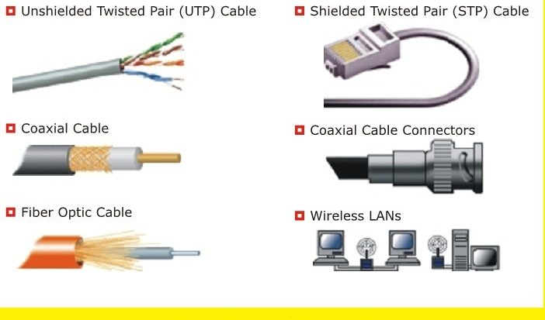
Introduction to Cables

Slide 2
Types of Cables
Coaxial Cables
Twisted Pair Cables
Fiber Optics Cable

Slide 3
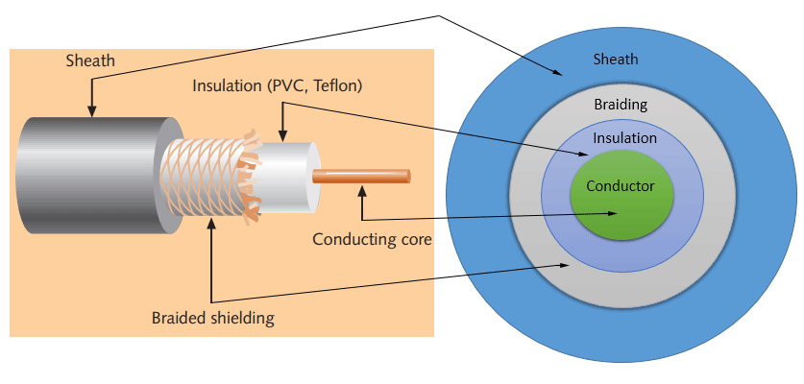
Coaxial Cable

Slide 4
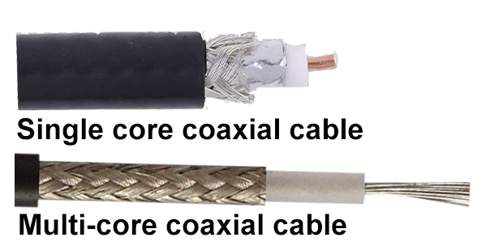
Coaxial Cable

Slide 5
Specifications of coaxial cables
Type | Ohms | AWG | Conductor | Description
RG-6 | 75 | 18 | Solid copper | Used in cable network to provide cable Internet service and cable TV over long distances.
RG-8 | 50 | 10 | Solid copper | Used in the earliest computer networks. This cable was used as the backbone cable in the bus topology. In Ethernet standards, this cable is documented as the 10base5 Thicknet cable.
RG-58 | 50 | 24 | Several thin strands of copper | This cable is thinner, easier to handle and install than the RG-8 cable. This cable was used to connect a system with the backbone cable. In Ethernet standards, this cable is documented as the 10base2 Thinnet cable.
RG-59 | 75 | 20 - 22 | Solid copper | Used in cable networks to provide short-distance service.

Slide 6
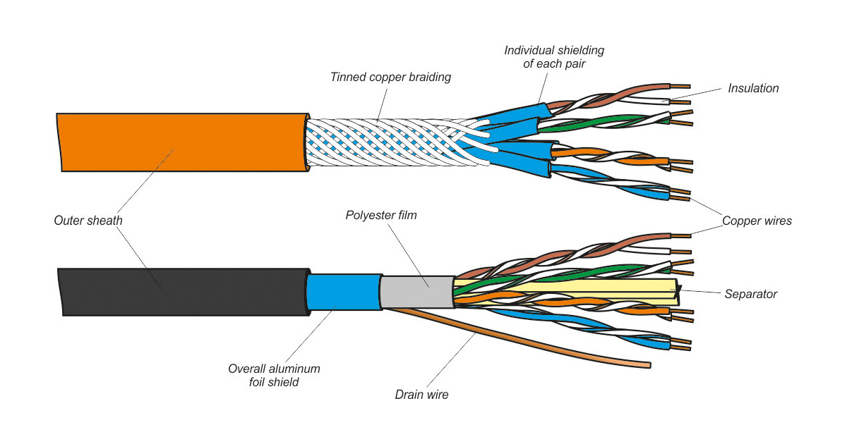
Twisted-pair cables

Slide 7
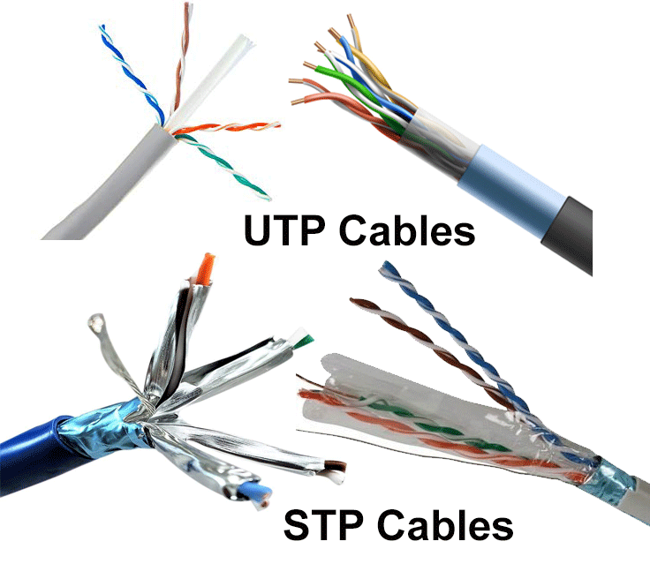
Similarities and differences between STP and UTP cables
Both STP and UTP can transmit data at 10Mbps, 100Mbps, 1Gbps, and 10Gbps.
Since the STP cable contains more materials, it is more expensive than the UTP cable.
Both cables use the same RJ-45 (registered jack) modular connectors.
Both cables can accommodate a maximum of 1024 nodes in each segment.
The STP provides more noise and EMI resistance than the UTP cable.
The maximum segment length for both cables is 100 meters or 328 feet.

Slide 8
Specifications of Twisted pair cables
Category/name of the cable | Maximum supported speed | Bandwidth/support signals rate | Ethernet standard | Description
Cat 1 | 1Mbps | 1MHz | Not used for data | This cable contains only two pairs (4 wires). This cable was used in the telephone network for voice transmission.
Cat 2 | 4Mbps | 10MHz | Token Ring | This cable and all further cables have a minimum of 8 wires (4 pairs). This cable was used in the token-ring network.
Cat 3 | 10Mbps | 16MHz | 10BASE-T Ethernet | This is the first Ethernet cable that was used in LAN networks.
Cat 4 | 20Mbps | 20MHz | Token Ring | This cable was used in advanced Token-ring networks.
Cat 5 | 100Mbps | 100MHz | 100BASE-T Ethernet | This cable was used in advanced (fast) LAN networks.
Cat 5e | 1000Mbps | 100MHz | 1000BASE-T Ethernet | This cable/category is the minimum requirement for all modern LAN networks.
Cat 6 | 10Gbps | 250MHz | 10GBASE-T Ethernet | This cable uses a plastic core to prevent cross-talk between twisted-pair. It also uses a fire-resistant plastic sheath.
Cat 6a | 10Gbps | 500MHz | 10GBASE-T Ethernet | This cable reduces attenuation and cross-talk. This cable also potentially removes the length limit. This is the recommended cable for all modern Ethernet LAN networks.
Cat 7 | 10Gbps | 600MHz | Not drafted yet | This cable sets a base for further development. This cable uses multiple twisted-pair and shields each pair by its plastic sheath.
Cat 1, 2, 3, 4, 5 are outdated and not used in any modern LAN network.
Cat 7 is still a new technology and not commonly used.
Cat 5e, 6, 6a are the commonly used twisted-pair cables.

Slide 9
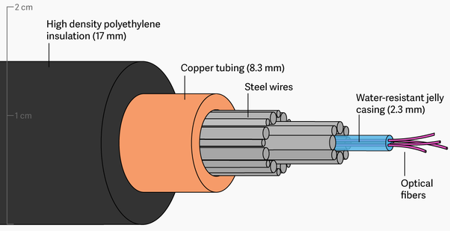
Fiber Optic Cable

Slide 10
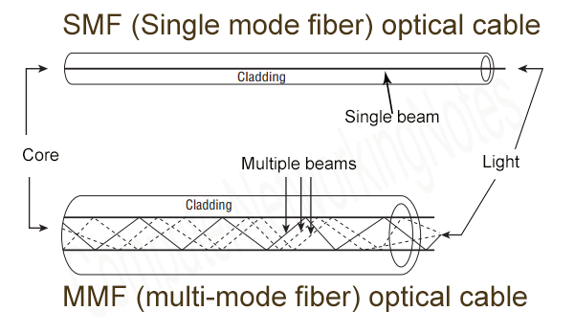
Two types of fiber optical cable; SMF and MMF.
SMF (Single-mode fiber) optical cable
This cable carries only a single beam of light. This is more reliable and supports much higher bandwidth and longer distances than the MMF cable. This cable uses a laser as the light source and transmits 1300 or 1550 nano-meter wavelengths of light.
MMF (multi-mode fiber) optical cable
This cable carries multiple beams of light. Because of multiple beams, this cable carries much more data than the SMF cable. This cable is used for shorter distances. This cable uses an LED as the light source and transmits 850 or 1300 nano-meter wavelengths of light.

